Slide 1
Competition for Patient Recruitment in Nearby Clinical Trial Neighborhoods
Problem: could neighboring clinical trials be diluting the same subset of the population?
Solution: functionality for assessing patient recruitment competition between a new clinical trial and other clinical trials within a radius

Slide 2
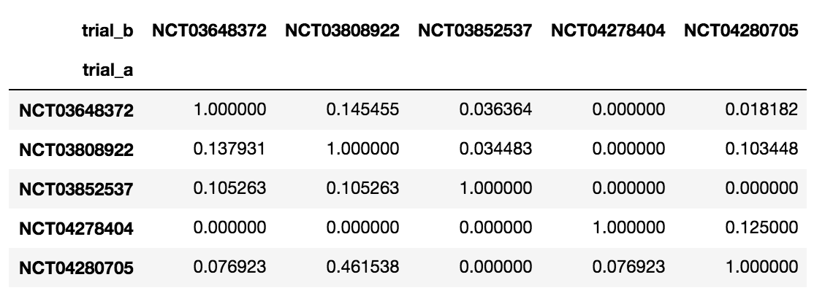
Defining Similarity
One possible definition among many: percentage of clinical trial’s criteria that match with neighboring clinical trial
Lends to a matrix:

